Slide 1
Hebbian Learning
Instructor: Dr. Mohammad Rashedur Rahman

Slide 2
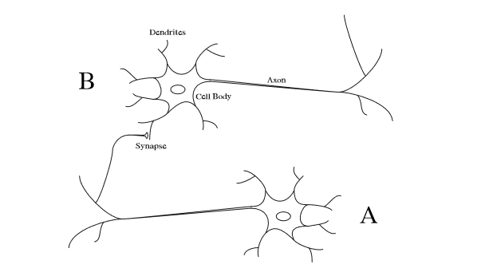
Hebb’s Postulate
“When an axon of cell A is near enough to excite a cell B and repeatedly or persistently takes part in firing it, some growth process or metabolic change takes place in one or both cells such that A’s efficiency, as one of the cells firing B, is increased.”
D. O. Hebb, 1949

Slide 3
Extended Hebb Rule
Hebb proposed that learning occurs by modification of synapse strengths (weights) in a manner such that if two interconnected neurons are both “on” at the same time, then the weight between those neurons should be increased.
The original statement only talks about neurons firing at the same time and does not say about reinforcing neurons that do not fire at the same time.
However a stronger form of learning occurs if we also increase the weights of the neurons that are “off” at the same time.
We call this as “Extended Hebb Rule” [ McClelland and Rumelhart, 1988] and it has an improved computational power and refer as Hebb rule.

Slide 4
Learning Algorithm in Hebb Net
We refer to a single layer (feedforward) neural net trained using the extended Hebb rule as Hebb net.
Since we are considering a single layer net, one of the interconnected neurons will be an input unit and one and one an output unit.
The linear associator is an example of a type of neural network called an associative memory. The task of an associative memory is to learn Q pairs of prototype input/output vectors:
{ {p1, t1} {p2, t2} ….. {pq, tq} }
In other words, if the network receives an input p=p_{q} then it should producean output a=t_{q}, for . In addition, if the input is changed slightly (i.e., p=p_{q}+c) then the output should only be changed slightly (i.e., a=t_{q}+d).

Slide 5
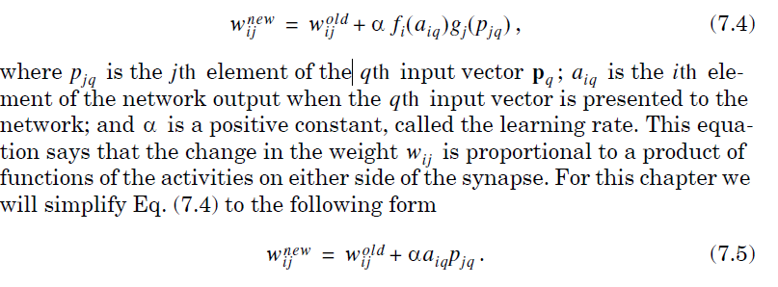
Mathematically Interpretation of Hebb rule
First, let’s rephrase the postulate: If two neurons on either side of a synapse are activated simultaneously, the strength of the synapse will increase. We can easily notice that that the connection (synapse) between input and output is the weight .
Therefore Hebb’s postulate would imply that if a positive p_{j} produces a positive a_{i} then the weight w_{ij} should increase. This suggests that one mathematical interpretation of the postulate could be

Slide 6
Mathematical Interpretation of Hebb Rule (cont..)
Note that this expression actually extends Hebb’s postulate beyond its strict interpretation.
The change in the weight is proportional to a product of the activity on either side of the synapse. Therefore, not only do we increase the weight when both p_{j} and a_{i} are positive, but we also increase the weight when they are both negative.
In addition, this implementation of the Hebb rule will decrease the weight whenever p_{j} and a_{i} have opposite sign.

Slide 7
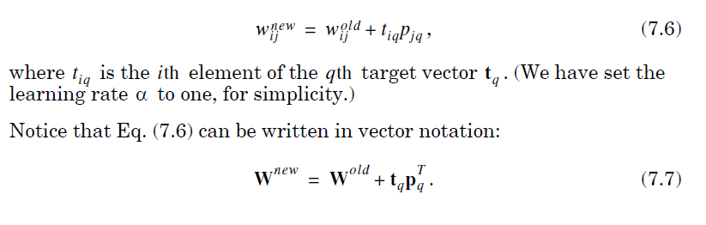
Mathematical Interpretation of Hebb Rule (cont..)
The Hebb rule defined in Eq. (7.5) is an unsupervised learning rule. It does not require any information concerning the target output.
In this chapter we are interested in using the Hebb rule for supervised learning, in which the target output is known for each input vector. For the supervised Hebb rule we substitute the target output for the actual output. In this way, we are telling the algorithm what the network should do, rather than what it is currently doing.
The resulting equation is

Slide 8
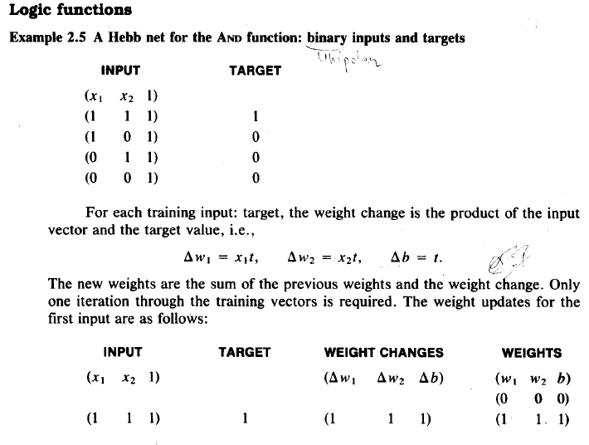
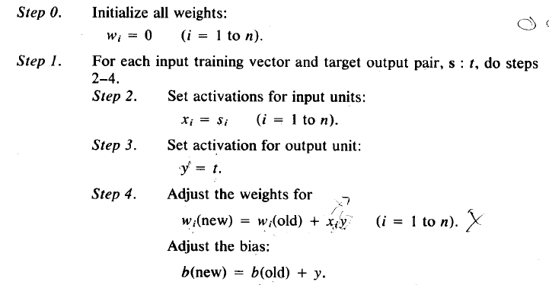
Example of Hebb Net for Simple AND (Input are binary(1,0) and output is binary (1,0)

Slide 9
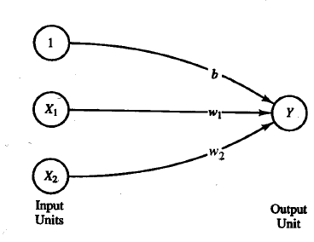
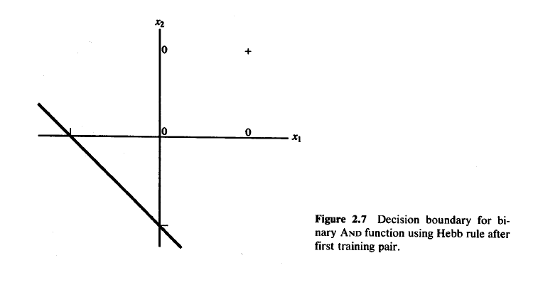
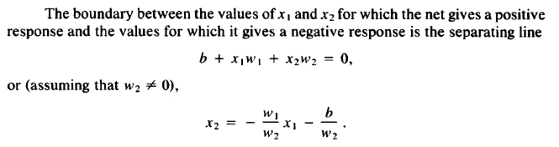
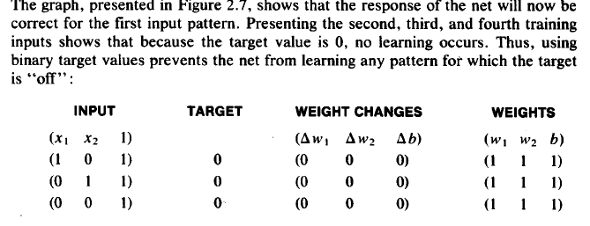
Hebb Net Learning Example
Now the separating line becomes x2= -x1-1

Slide 10
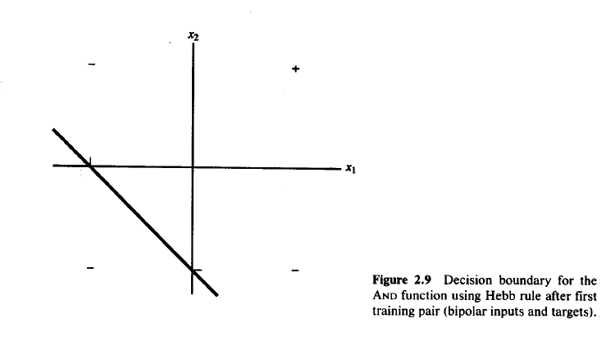
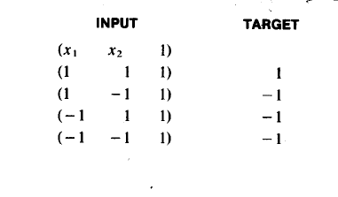
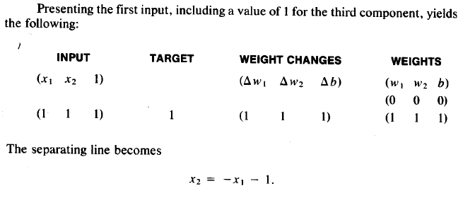
Hebb Net Learning for AND with Bipolar Signal (1,-1)

Slide 11
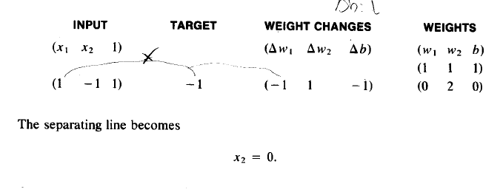
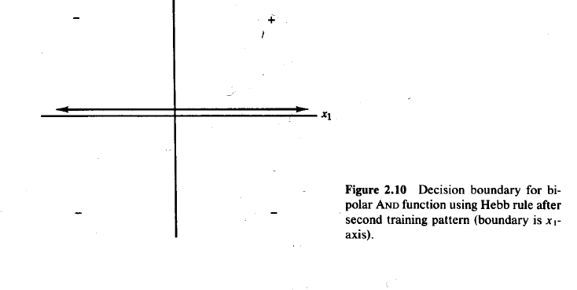
Hebb Net Learning for AND with Bipolar Signal (1,-1) (Cont..)
Presenting second Input will give

Slide 12
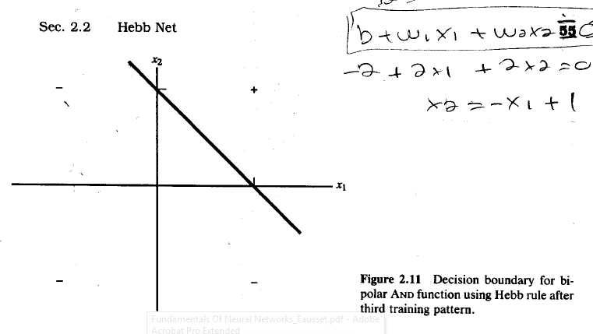
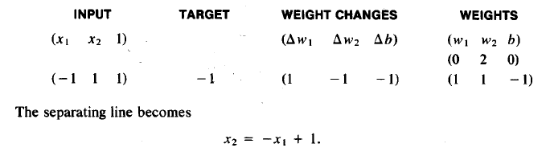
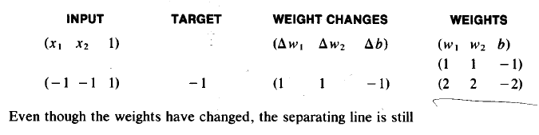

Hebb Net Learning for AND with Bipolar Signal (1,-1) (Cont..)
Presenting Third Input will give
Presenting Last Input will give

Slide 13
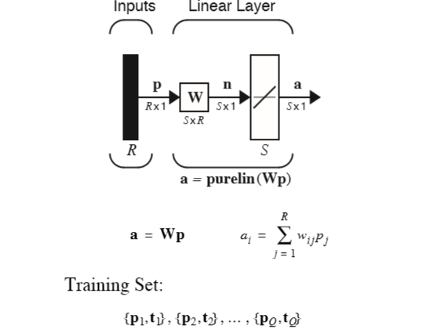
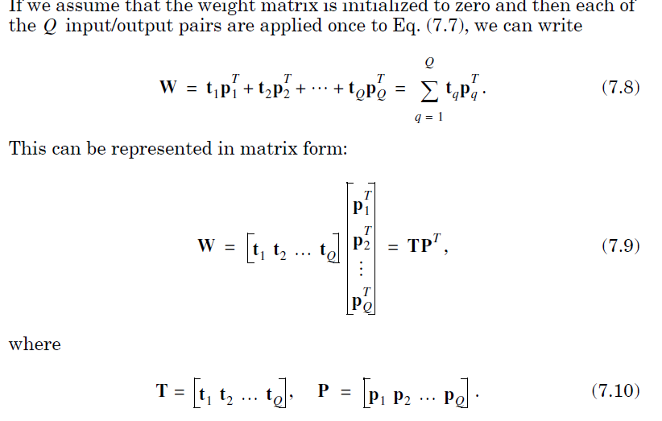
Hebb Net is Like Linear Associator

Slide 14
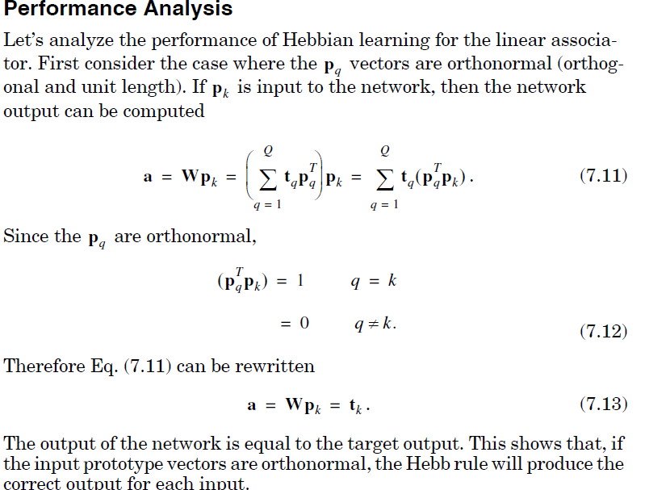
Performance Analysis of Hebb Net

Slide 15
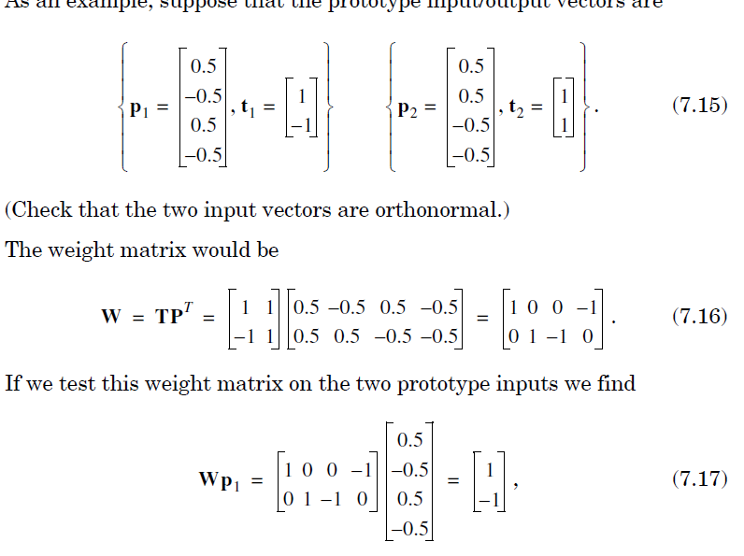
An example of Orthonormal Input Pattern

Slide 16
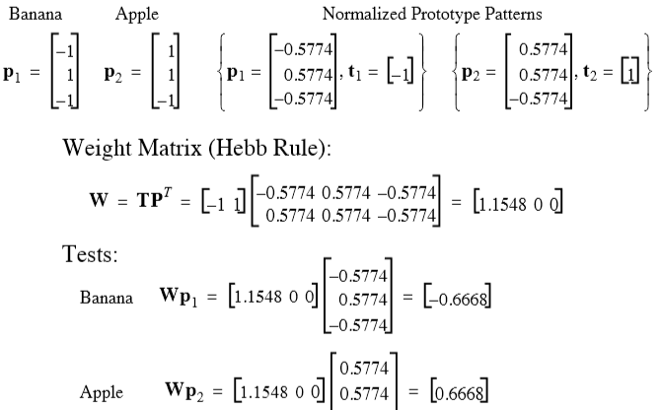
Apple Banana Example (Not Orthonormal)

Slide 17
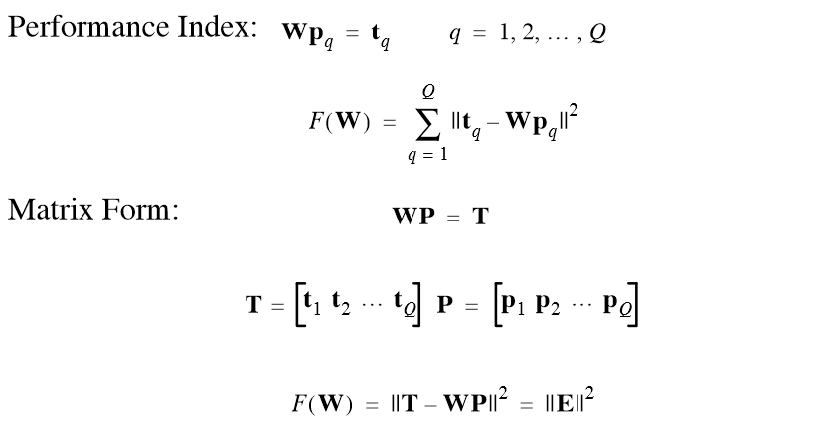
Pseudo-Inverse Rule

Slide 18
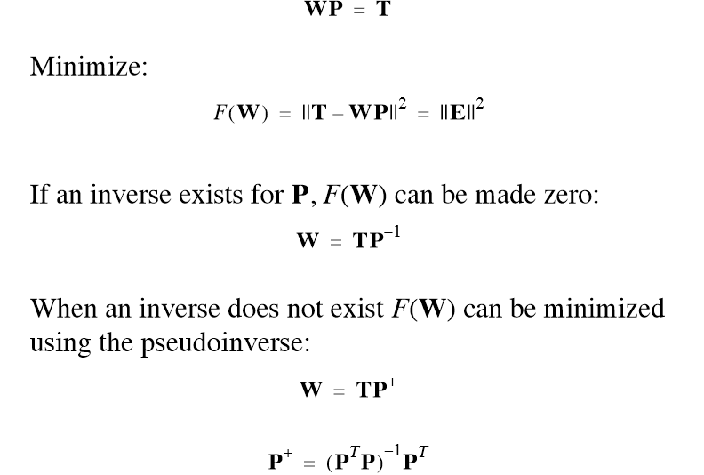
Pseudo-Inverse Rule (Cont..)

Slide 19
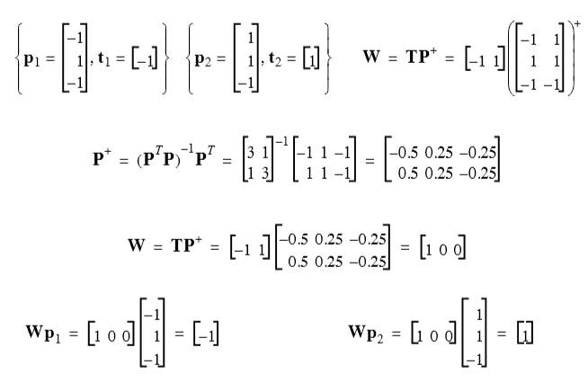
Apple- Banana Example with Pesudoinverse

Slide 20
Application of Hebb Rule in Pattern Recognition
Now let’s see how we might use the Hebb rule on a practical, although greatly oversimplified, pattern recognition problem.
For this problem we will use a special type of associative memory — the autoassociative memory.
In an autoassociative memory the desired output vector is equal to the input vector (i.e.t_{q}=p_{q}, ).
We will use an autoassociative memory to store a set of patterns and then to recall these patterns, even when corrupted patterns are provided as input.

Slide 21
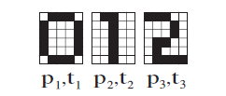

Application of Hebb Rule in Pattern Recognition (Cont..)
The patterns we want to store are shown to the left. (Since we are designing an autoassociative memory, these patterns represent the input vectors and the targets.)
They represent the digits {0, 1, 2} displayed in a 6X5 grid. We need to convert these digits to vectors, which will become the prototype patterns for our network.
Each white square will be represented by a “-1”, and each dark square will be represented by a “1”. Then, to create the input vectors, we will scan each 6X5 grid one column at a time. For example, the first prototype pattern will be

Slide 22

Application of Hebb Rule in Pattern Recognition (Cont..)
The vector p1 corresponds to the digit “0”, p2 to the digit “1”, and p3 to the digit “2”.
Using the Hebb rule, the weight matrix is computed
Because there are only two allowable values for the elements of the prototype vectors, we will modify the linear associator so that its output elements can only take on values of “-1” or “1”.
We can do this by replacing the linear transfer function with a symmetrical hard limit transfer function.
The resulting network is displayed in next slide

Slide 23
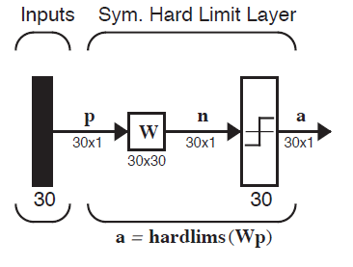
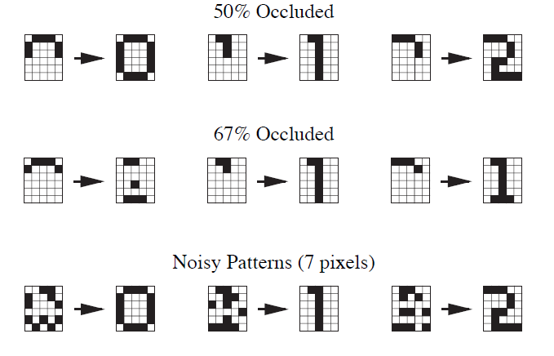
Application of Hebb Rule in Pattern Recognition (Cont..)

